Slide 1
文檔
2019-04-13(六)

Slide 2
接收手機端需求
1.Client首先會接收到request from android
2.這個request包括
寄件地址+收件地址(以經緯度型態表示)
貨車抵達收件人地址的time interval挑選
訂貨單號跟車子的關係(一對一 V.S 多對一)
3.Client會把傳入的source geo-position, desitnation geo-position轉成Sender Address edgeID, Receiver Address edgeID, Sender gui-position and Receiver gui-position
4.Client也會對現況所有車子做getPosition()與getRoadID(), 取得每一台車的gui-position與目前位置edgeID

Slide 3
計算現有車輛與Sender之間距離
1.剛剛把所有的車輛資訊，提取each vehicle gui-posion(假如10台車)，那計算這10台車(car1,car2,…car3)與sender gui-position之間的距離
2.利用getDistance2D(self, x1, y1, x2, y2, isGeo=False, isDriving=False) getDistance2D(double, double, double, double, boolean, boolean) -> double
3. distance5=min{distance1, distance2,…distance10}
4.那就把car5認定成配送車

Slide 4
動態路徑規劃
1.把剛才挑選的car5設定為派遣車輛，取得car5的gui-position(x,y座標)與car5_roadID(也就是car5_edgID)
2.給startEdge: car5_edgID, endEdge:sender_address_edgeID
3.接著是動態規畫路徑，目前還沒查到ws的相關用法，所以用TraCI(python)代替表示:
traci.route.add("trip", ["startEdge", "endEdge"])
traci.vehicle.add(“newVeh”, “trip”, typeID=“reroutingType”) //增加這台車
4.關鍵在於如何用scripts與起始終點邊，規劃出一條route，，比較接近的是ws.RouteAdd(String routeID, List<String> edges)

Slide 5
前往sender address
1.從car5目前所在地，前往sender address時，要停下來
2.因此用到該函數Vehicle_setStop
3.public void Vehicle_setStop(String vehID, String edgeID, double pos, byte laneIndex, int duration, SumoStopFlags stopType)
4. Class SumoStopFlags //http://sumo.sourceforge.net/javadoc/traas/de/tudresden/ws/container/SumoStopFlags.html
5.注意SumoStopFlags有很多parameters，例如isStopped, setStopped, isContainerTriggered, setIsContainerStop
6.當車子到sender address時，要做isIsContainerStop()的參數調整，還有load container的調整
7.SumoStopFlags能用的method like notify(),wait()

Slide 6
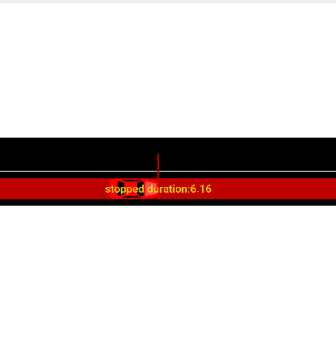
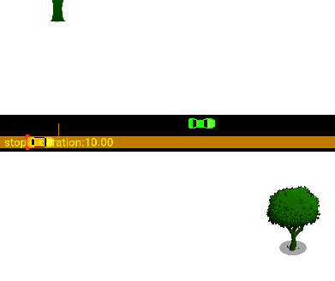

Slide 7
從收件者到寄件者位置
1.當再車子在sender停下來時，會計算stop duration，例如停10秒
2.再10結束後，應當安排從寄件者到收件者路徑規劃，
traci.route.add("trip_StoR", [“senderEdge", “ReciverEdge"])
traci.vehicle.add(“newVeh”, “trip_StoR”, typeID=“reroutingType”)
setContainerStop()
3. setContainerStop(self, vehID, stopID, duration=-1073741824.0, until=-1073741824.0, flags=0)
setContainerStop(string, string, double, double, integer) -> None Adds or modifies a container stop with the given parameters.
The duration and the until attribute are in seconds.
4.當arrive receiver address時，要停留一陣子，並且用SumoStopFlags的method like notify()外界

Slide 8
Geo-postion to gui-position
System.out.println(conn.do_job_get(Simulation.convertGeo(3414.680, 5591.166, false ))); // 120.22115148153793,22.985924116857188
System.out.println(conn.do_job_get(Simulation.convertGeo(120.216228, 22.987473, true ))); // 2912.904071369441,5772.349525868427
After
Before
Lon:120.216228
Lat:22.987473
用clipboard貼上的
X:2912.41
Y:5772.38
X:2912.904071369441
Y:5772.349525868427
誤差
X_before:2912.41
X_after:2912.904071369441
Y_before:5772.38
Y_after:Y:5772.349525868427

Slide 9
Gui-postion to Geo-position
Before
After
X:3414.680
Y:5591.166
用clipboard貼上的
lon:120.221146
lat:22.985924
Lon:120.22115148153793
Lat:22.985924116857188
誤差
Lon(前 v.s 後)
120.221146
120.22115148153793
Lat(前 v.s 後)
22.985924
22.985924116857188

Slide 10
getDistance2D
getDistance2D(double x1, double y1, double x2, double y2, boolean isGeo, boolean isDriving)
isDrving=true 2362.2630483917073 [m]
isDrving=false
2284.551904816347[m]
double startPosX = 4061.28;
double startPosY = 5207.22;
double endPosX = 2052.75;
double endPosY = 6295.79;
double startPosX = 4061.28;
double startPosY = 5207.22;
double endPosX = 2052.75;
double endPosY = 6295.79;

Slide 11
getDistanceRoad
getDistanceRoad(String edgeID1, double pos1, String edgeID2, double pos2, boolean isDriving)
(isDrving=true & isGeo=false) 2268.47 [m]
(isDrving=false & isGeo=false)
2204.4200443880927 [m]
String startEdgeId = "307244665#2";
String endEdgeId = "496332196#1";
double pos1 = 0.0;
double pos2 = 0.0;
String startEdgeId = "307244665#2";
String endEdgeId = "496332196#1";
double pos1 = 0.0;
double pos2 = 0.0;

Slide 12
findRoute
System.out.println(conn.do_job_get(
Simulation.findRoute(fromEdge, toEdge, vType, depart, routingMode)));
error
參數
String fromEdge = "307244665#2";
String toEdge = "496332196#1";
String vType = "routeByDistance";
double depart = 40;
int routingMode = 0;s
java.lang.IllegalStateException: Error reading byte, invalid list position specified for reading: 706
at de.uniluebeck.itm.tcpip.Storage.readByte(Storage.java:141)
at de.uniluebeck.itm.tcpip.Storage.readString(Storage.java:502)
at de.uniluebeck.itm.tcpip.Storage.readStringASCII(Storage.java:462)
at de.tudresden.sumo.util.CommandProcessor.readStage(CommandProcessor.java:860)
at de.tudresden.sumo.util.CommandProcessor.do_job_get(CommandProcessor.java:762)
at it.polito.appeal.traci.SumoTraciConnection.do_job_get(SumoTraciConnection.java:376)
at Main.main(Main.java:135)

Slide 13
getDistance2D
System.out.println(conn.do_job_get (Simulation.getDistance2D(startLon, startLat, endLon, endLat, true, false)));
參數
error
double startLon = 120.227524;
double startLat = 22.982570;
double endLon = 120.207748;
double endLat = 22.992048;
SUMO error for command 171: Unknown position format used for distance request //java-console
----------------------------------------------
Error: Answered with error to command 0xab: Unknown position format used for distance request
Error: tcpip::Socket::recvAndCheck @ recv: peer shutdown
Quitting (on error). //gui-console

Slide 14
convertRoad
System.out.println(conn.do_job_get
(Simulation.convertRoad(2466.06, 7243.26, false, "ignoring")));
參數
error
double x = 2466.06;
Double y = 7243.26;
Boolean isGeo =false;
String vClass = “ignoring”;
SUMO error for command 171: Position conversion requires a source position and a position type as parameter.//java-console
-------------------------------------------------------------
Error: Answered with error to command 0xab: Position conversion requires a source position and a position type as parameter. //sumo-gui

Slide 15
convertRoad
System.out.println(conn.do_job_get
(Simulation.convertRoad(2466.06, 7243.26, false, "ignoring")));
參數
double x = 2466.06;
Double y = 7243.26;
Boolean isGeo =false;
String vClass = “ignoring”;
:3078271785_0, 4.018174942844767, 0
String edgeID=“3078271785_0”
double position:
int laneIndex:

Slide 16
convertRoad
System.out.println(conn.do_job_get(Simulation.convertRoad(120.227524, 22.982570, true, "ignoring")));
參數
double lon = 120.227524;
double lat = 22.982570;
Boolean isGeo =true;
String vClass = “ignoring”;
120.22752444040958,
22.982570512551675
307244665#2, 3.6605540809902037, 0
String edgeID=“307244665#2”
double position: 3.6605540809902037
int laneIndex: 0

Slide 17
Map Generation
$polyconvert --net-file map_edited.net.xml --osm-files map2.osm --type-file typemap.xml --output tainan.poly.xml
$ python randomTrips.py --net-file map_edited.net.xml --end 10 -l --output map.trip.xml
$ python randomTrips.py -n map_edited.net.xml –r map.rou.xml -e 10 –l

Slide 18
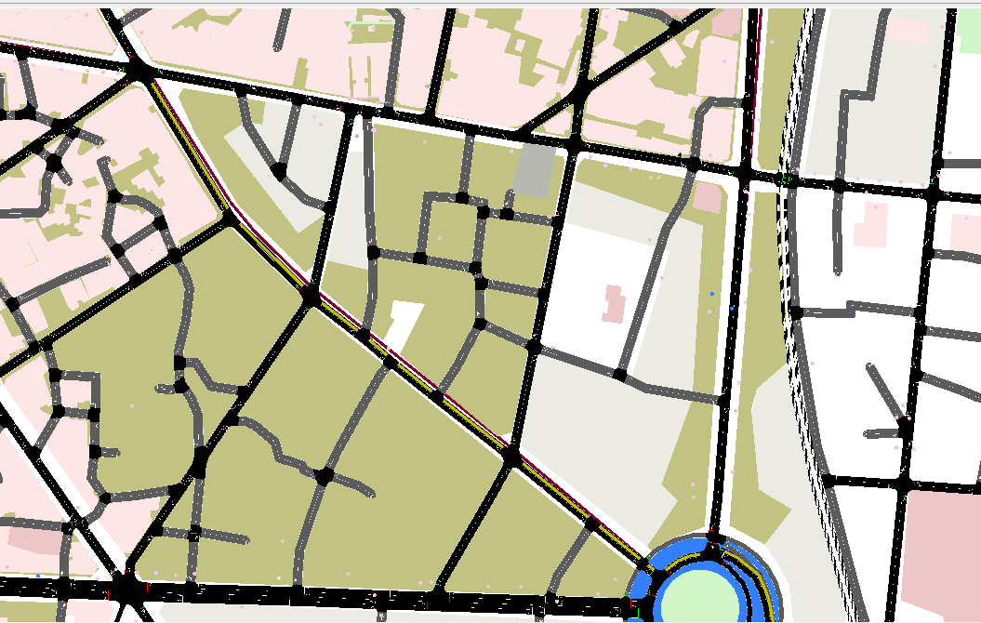

Slide 19
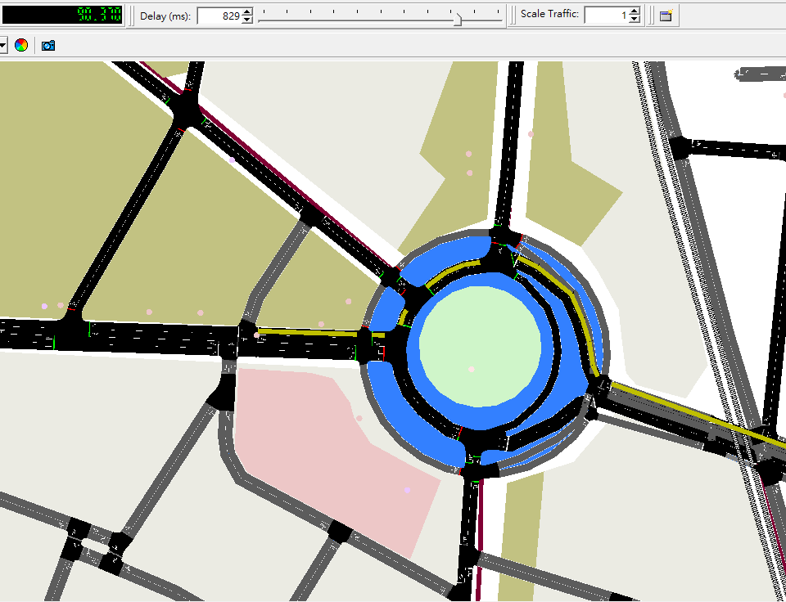

Slide 20
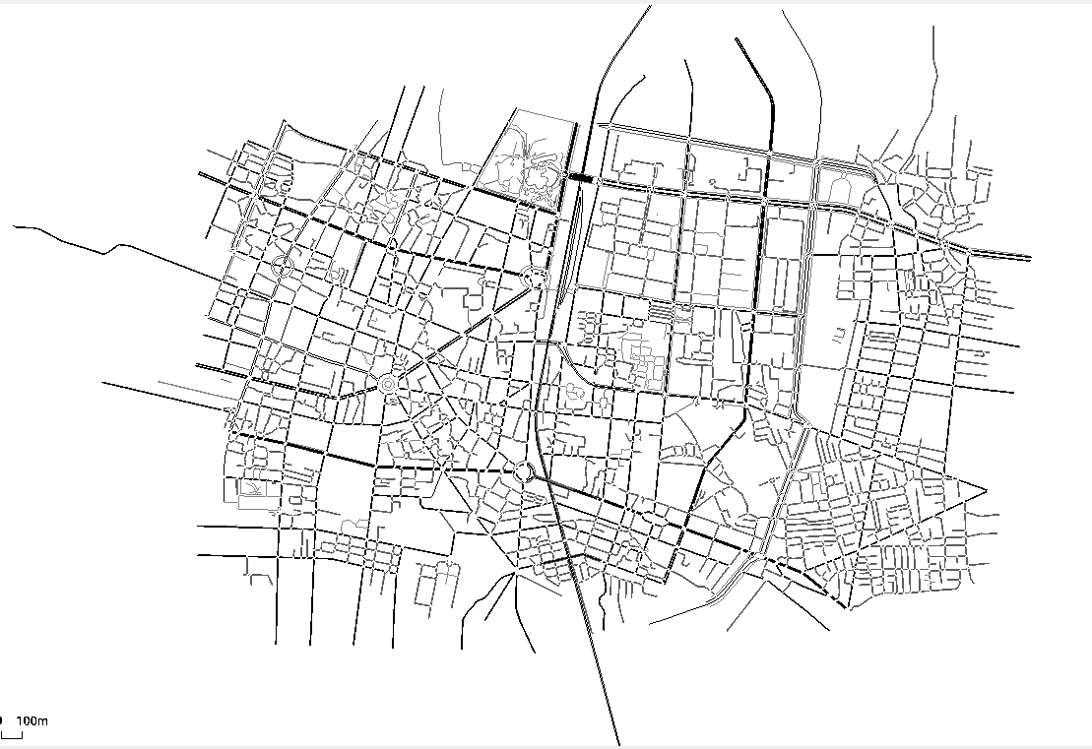
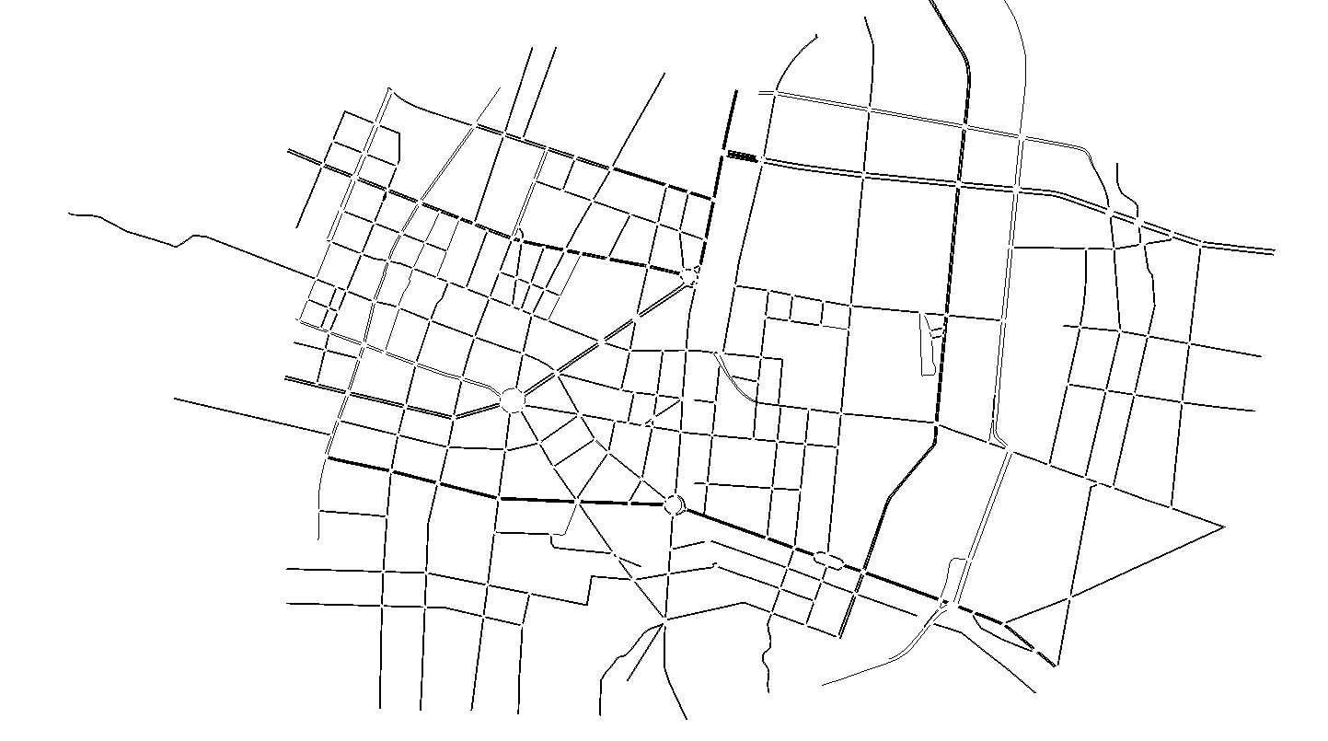

Slide 21
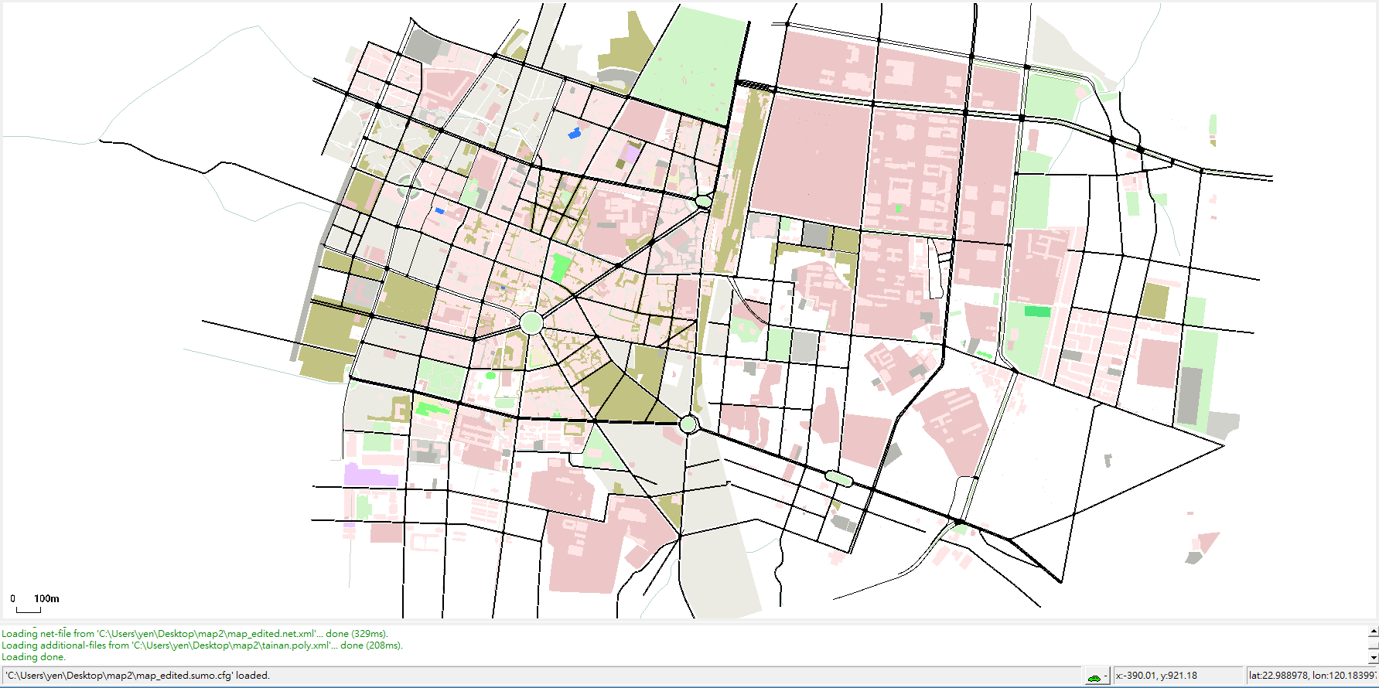

Slide 22
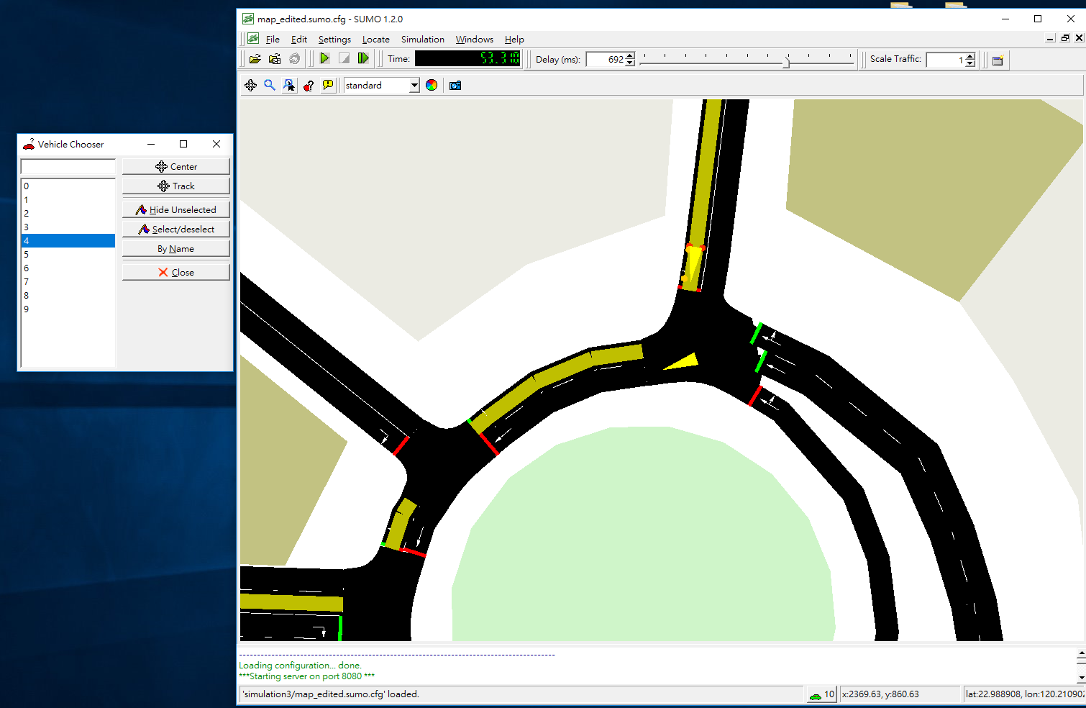

Slide 23
Progress report
Date:2019-04-29
converRoad issue fixed
findRoute issue fixed
changeRoute demo
Next Step

Slide 24
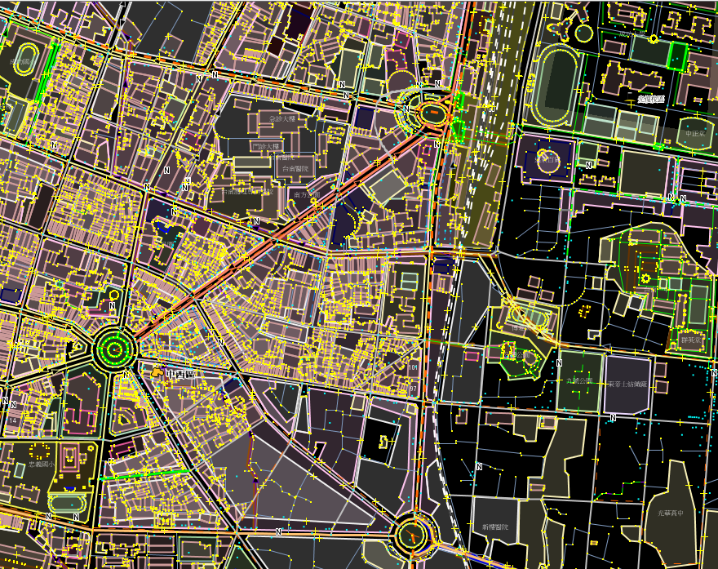
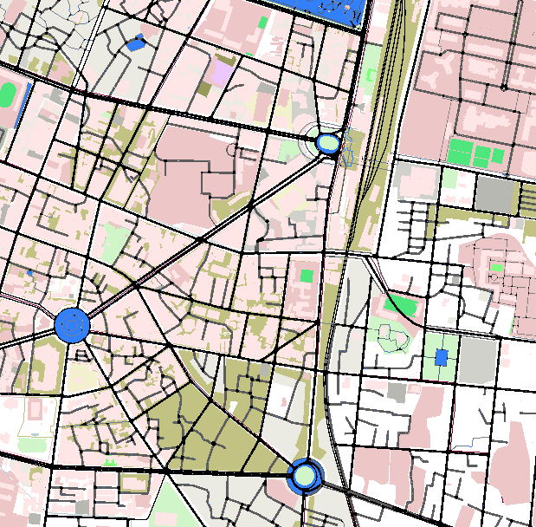
OSM
Sumo-gui

Slide 25
convertRoad
------------convert2D part-------------
convert2D('496249899#1', 0.6669427384818771, (byte)0, false)
Result:2467.957,6810.675
------------convertRoad part------------
convertRoad(2467.957, 6810.675 , false, "ignoring")
Result:496249899#1, 0.6669427384818679, 0

Slide 26
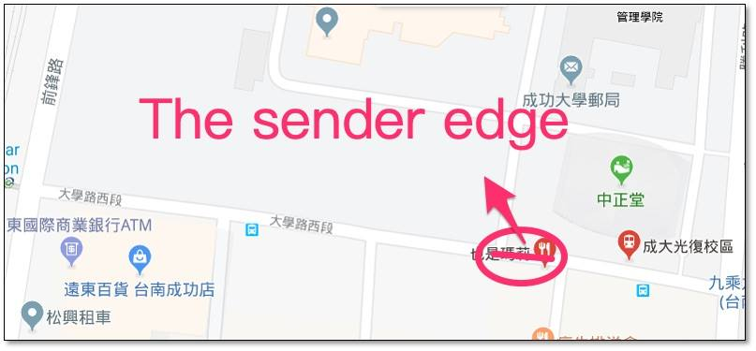
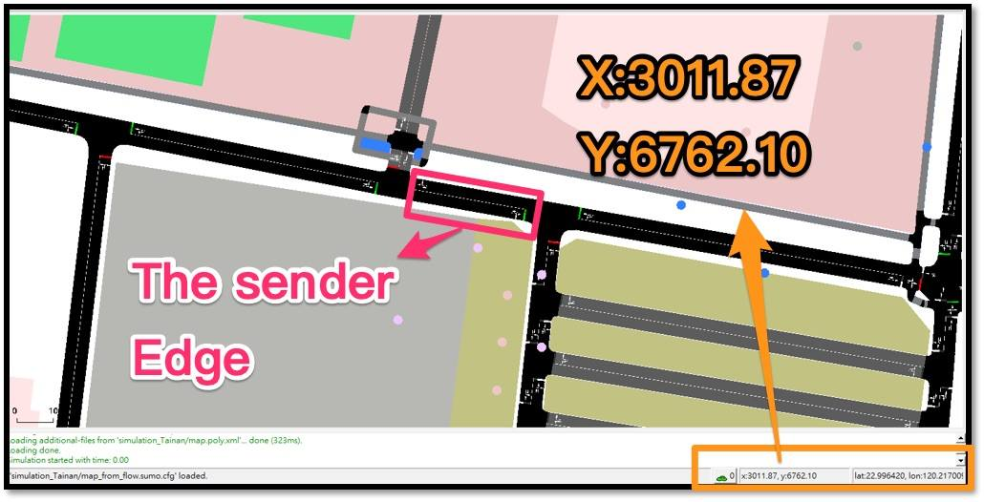
Sender address
(X,Y)=(2989.02, 6765.41)
(lon,lat)=(120.216786, 22.996446)
edgeID:”-537706053#2”

Slide 27
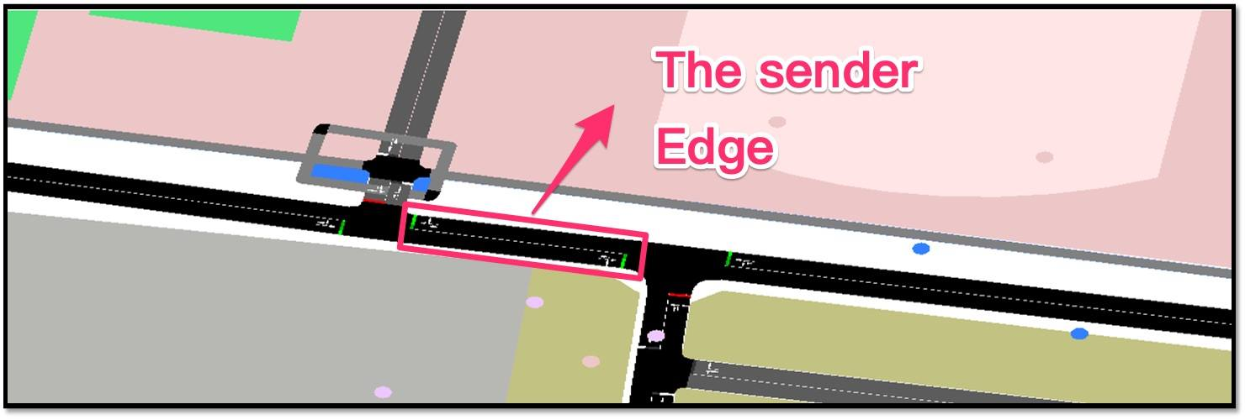
convert2D('-537706053#2', 0.0, (byte)0, false)
3013.7,6761.51
convertRoad(2989.02, 6765.41, false, 'ignoring'))
-537706053#2, 24.98140320859787, 0

Slide 28
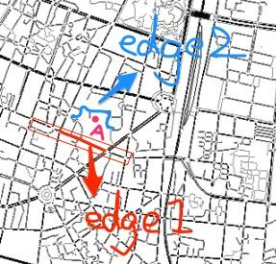
The precision problem of convertRoad

Slide 29
convertRoad(1387, 6497 , false, "ignoring")
<edge id=":1235793433_4" function="internal">
<lane id=":1235793433_4_0" index="0" disallow="tram rail_urban rail rail_electric ship" speed="13.89" length="11.04" shape="1388.94,6495.41
1391.56,6506.13"/>
</edge>
<edge id=":1235793433_5" function="internal">
<lane id=":1235793433_5_0" index="0" disallow="tram rail_urban rail rail_electric ship" speed="3.65" length="2.34" shape="1388.94,6495.41
1388.44,6496.76
1387.76,6497.34"/>
</edge>
<edge id=":1235793433_11" function="internal">
<lane id=":1235793433_11_0" index="0" disallow="tram rail_urban rail rail_electric ship" speed="3.65" length="2.34" shape="1387.76,6497.34
1386.89,6497.13
1385.83,6496.15"/>
</edge>

Slide 30
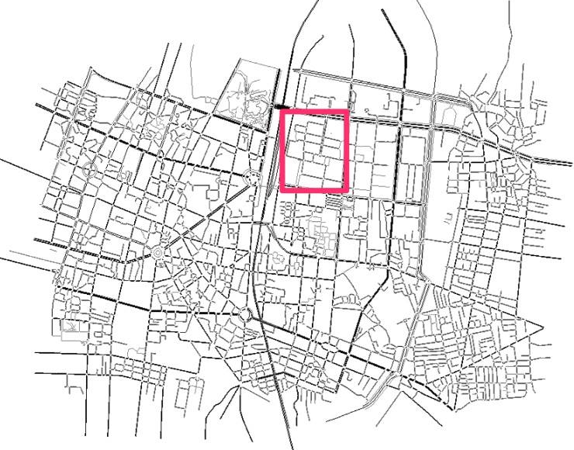
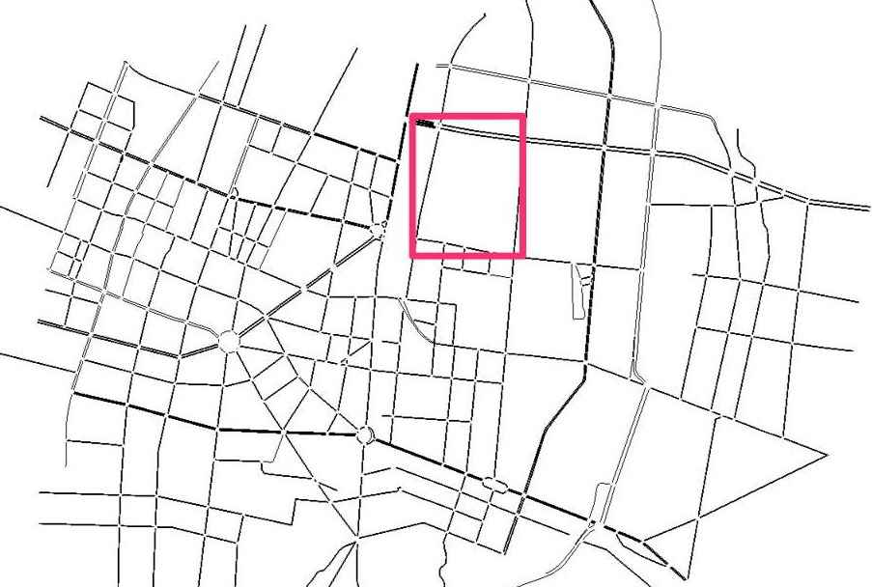
A solution to the pinpoint problem of convertRoad
Before
The edited version

Slide 31
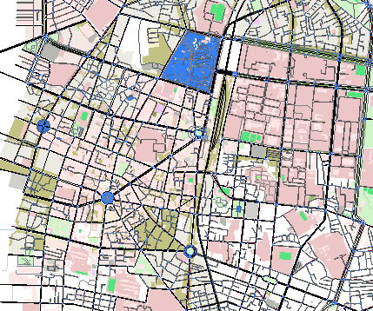
Remove the trivial lanes and make the map simple

Slide 32
findRoute
SumoStage stage = (SumoStage) conn.do_job_get(Simulation.findRoute(fromEdge, toEdge, vType, depart, routingMode));
String fromEdge = "307244665#4";
String toEdge = "31794904#2";
String vType = "routeByDistance";
double depart = 60.0;
int routingMode = 0;
newRoute:
[307244665#4, -298597678#5, -298597678#4, -298597678#3, -298597678#2, -298597678#1, -298597678#0, -298597679#4, -298597679#3, -298597679#2, -298597679#1, -298597679#0, -413131917, -186109367#5, -186109367#4, -186109367#3, -186109367#2, -186109367#1, -186109367#0, -316267745#1, -316267745#0, 667223560#0, 667223560#1, 41389171, -496261701#2, -496261701#1, -496261701#0, -41389179, 413128683, 413128684, 41389178, 160253728, 107538178#0, 31794904#0, 31794904#1, 31794904#2]

Slide 33
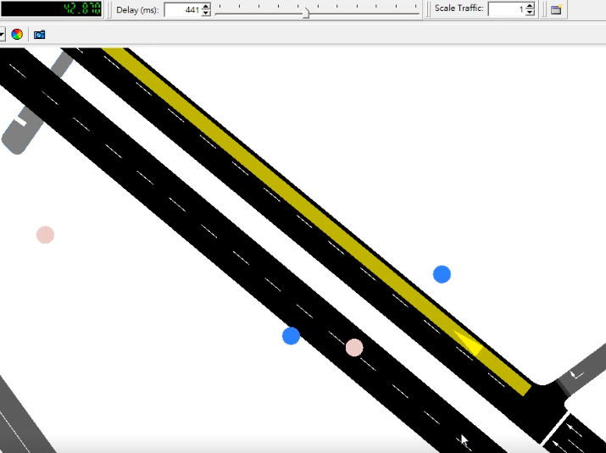
Vehicle ”flow0.0” starts at 40s

Slide 34
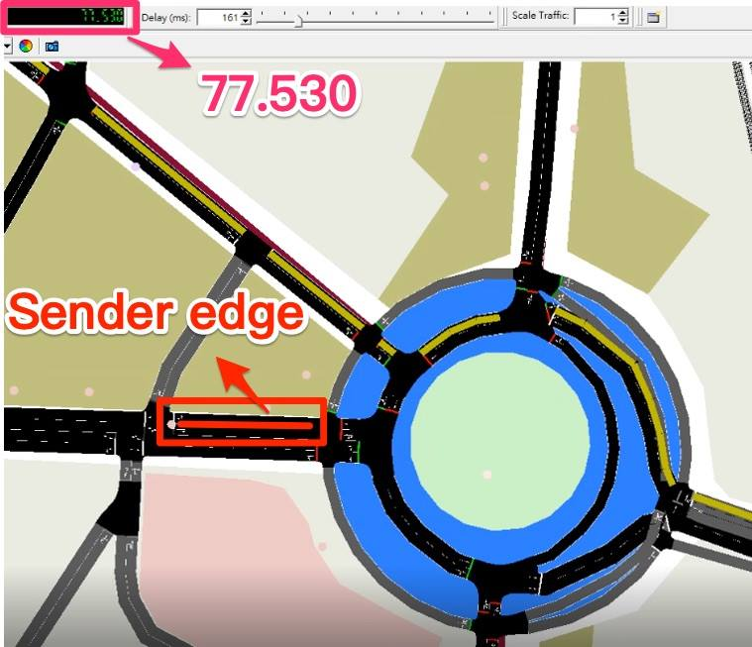
Follow default route from 40s-90s and re-built the new route when the sender have the request at 90s
If(time==90.0){
String senderEdgeID ="160253722#1";
Vehicle.changeTarget("flow0.0", senderEdgeID);
}

Slide 35
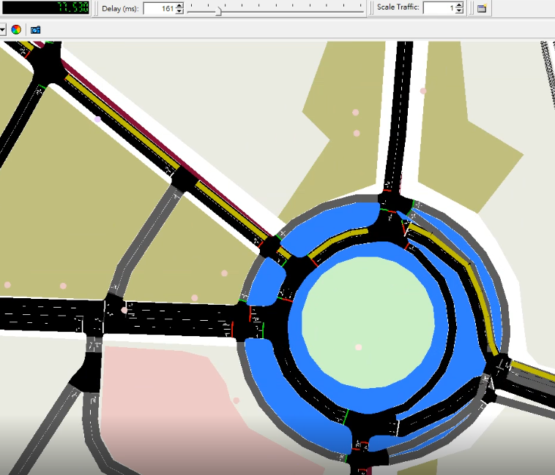
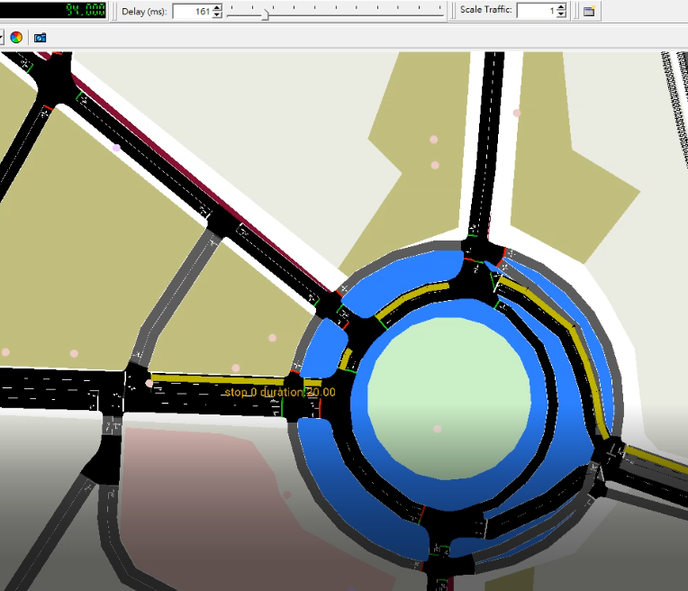
77.530s
94.000
(Vehicle.changeTarget("flow0.0", senderEdgeID));

Slide 36
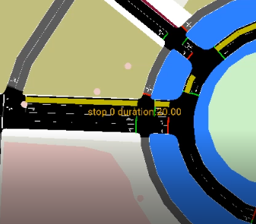
94.00s
if(timeSeconds==90.0) {
String senderEdgeID ="160253722#1";
changeTarget("flow0.0", senderEdgeID));
new SumoStopFlags(false, false, false, false, false);
double duration = 20.0;
setStop("flow0.0", senderEdgeID, 1.0, (byte)1, duration, sf_send));
// 計算到達receiver的travelTime
// 通知sender
}

Slide 37
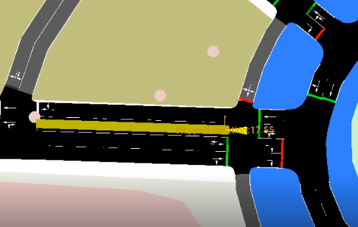
Vehicle stopped at position 1.0m of the lane in 192.0s
Vehicle.setStop
("flow0.0", senderEdgeID, 1.0, (byte)1,
Duration=20, SumoStopFlags));

Slide 38
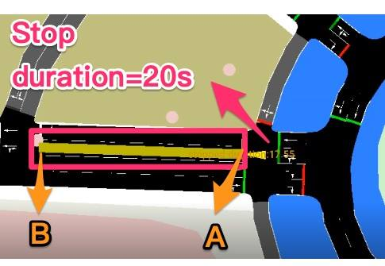
A route after the stop of the sender
A:192s A_stop:192-212s
B:217s
If we do not arrange the new route of this vehicle before arriving B, this car would disappear at B.

Slide 39
Re-build the new route
A_stop:192-212s
B:217s
if(timeSeconds==214.0) {
String receiverEdgeID = "-279032146#1";.
changeTarget("flow0.0", receiverEdgeID));
new SumoStopFlags
double duration = 20.0;
setStop("flow0.0", receiverEdgeID, 1.0, (byte)0, duration, sf_rec));
}

Slide 40
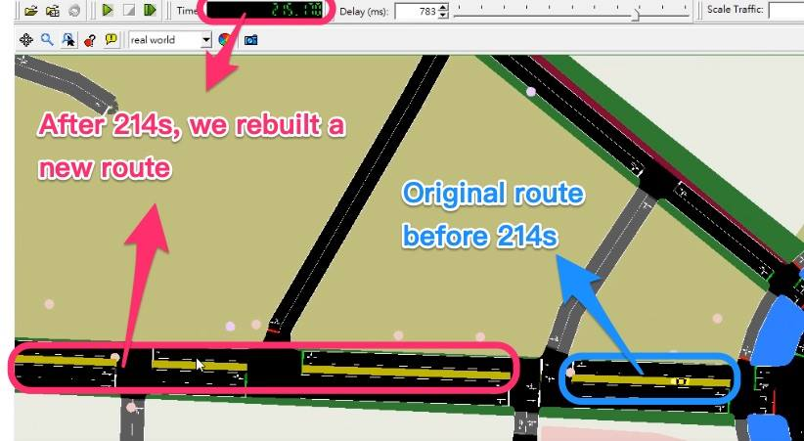
if(timeSeconds==214.0)
{
String receiverEdgeID = "-279032146#1";.
changeTarget("flow0.0", receiverEdgeID));
}

Slide 41
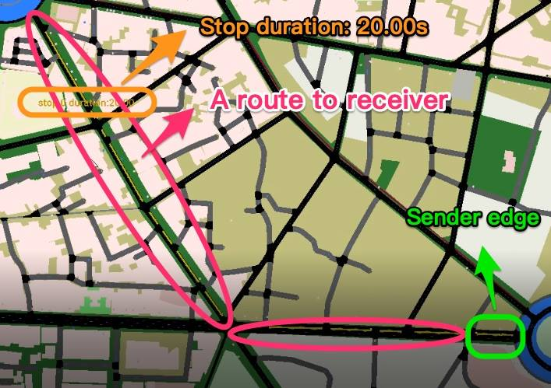
215.17s

Slide 42
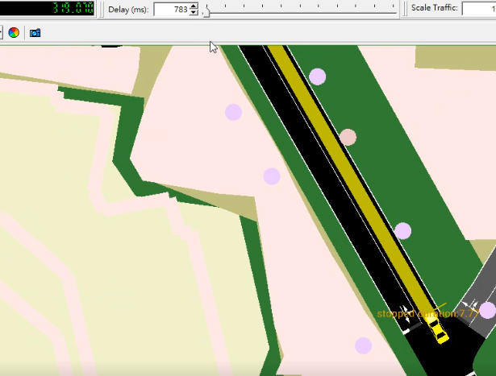
The car should stop for 20s in the edge of the receiver.

Slide 43
Next step
1.arrange 10 random cars in the more concise map
2.compute the minimum distance between the sender and the ten cars
3.Dispatch the selected car to the sender
4.Add travel-time estimation function and notification to the user connecting the Android
5.Try to receive the geo-position from user’s request and save it in a appropriate datatype (ex. arrayList)
6.Report the related data to the webserver (eg. the geo-position of the car)

Slide 44
if(timeSeconds==130.0) { String fromEdge = curEdge; String toEdge = "160253722#3";
String vType ="routeByDistance"; double depart = 60.0; int routingMode = 0;
SumoStage stage = (SumoStage)conn.do_job_get(Simulation.findRoute(fromEdge, toEdge, vType, depart,routingMode));
LinkedList<String> newRoute = new LinkedList<String>();
for (String eadge :stage.edges){ newRoute.add(eadge); }
System.out.println("newRoute:"+ newRoute);
newRoute:[413128684, 41389178, 160253728, 107538178#0, 107538178#1, 160253722#0, 160253722#1, 160253722#2, 160253722#3]

Slide 45
defaultRouteList:[
313194185#3, 313194185#6, 313194185#11, 313194185#14, 496257370#0, 405115648#1, 313194390#0, 675775398, 496257372, -315702598#2,
-228022792#6, -228022792#2, 72871344, 72871329#2, 72871329#3, 27067581, 228022808#0, 228022808#2, 228022808#4, 228022808#6, 306974310#0, 306974310#1]
changing Route:
changedRouteList:[313194185#3, 313194185#6, 313194185#11, 313194185#14, 496257370#0, 405115648#1, -307096543#5, -537706053#4, -537706053#2]
route from rou.xml
"313194185#3 313194185#6 313194185#11 313194185#14 496257370#0 405115648#1 313194390#0 675775398 496257372 -315702598#2
-228022792#6 -228022792#2 72871344 72871329#2 72871329#3 27067581 228022808#0 228022808#2 228022808#4 228022808#6 306974310#0 306974310#1"

Slide 46
String senderEdge=“'-537706053#2”
conn.do_job_set(Vehicle.setBusStop("8", senderEdge, 20.0, 100));
SUMO error for command 196: The BusStop '-537706053#2' is not known for vehicle '8'

Slide 47
String testPersonID = "ffw";String TestEdgeID = "160253722#1"; double testPos = 1.0; double testDepart = timeSeconds; String testTypeID = "DEFAULT_PEDTYPE"; conn.do_job_set(Person.add(testPersonID, TestEdgeID, testPos, testDepart, testTypeID)); System.out.print(conn.do_job_get(Person.getPosition("ffw"))); String stopID = "containerStop1"; conn.do_job_set(Person.appendWaitingStage(testPersonID, 20, "waiting", stopID));
Error: Answered with error to command 0xce: Invalid stopping place id 'containerStop1' for person: 'ffw'

Slide 48
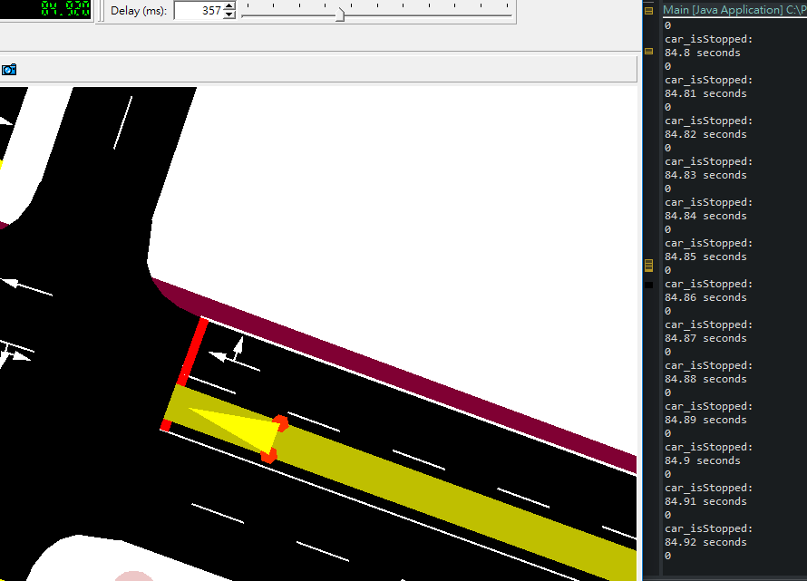

Slide 49
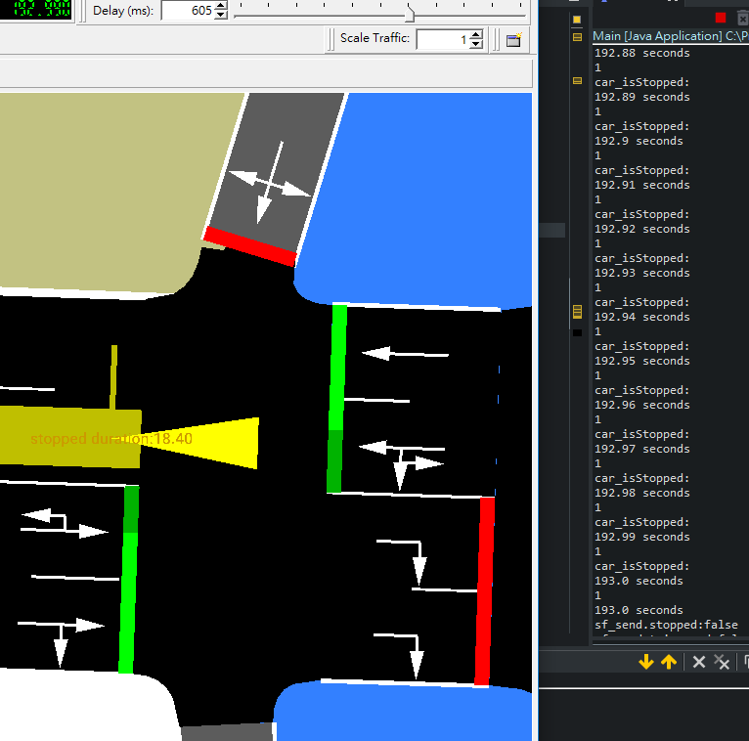

Slide 50
getStopState
System.out.println("getStopState");
int b = (Integer)conn.do_job_get(Vehicle.getStopState("flow0.0"));
System.out.println(b);
it.polito.appeal.traci.TraCIException$UnexpectedData: Unexpected : expected 7, got 9

Slide 51
isStoppedParking
conn.do_job_get(Vehicle.isStoppedParking("flow0.0"))
it.polito.appeal.traci.TraCIException$UnexpectedData: Unexpected : expected 7, got 9
at de.tudresden.sumo.util.Query.verify(Query.java:258)

Slide 52
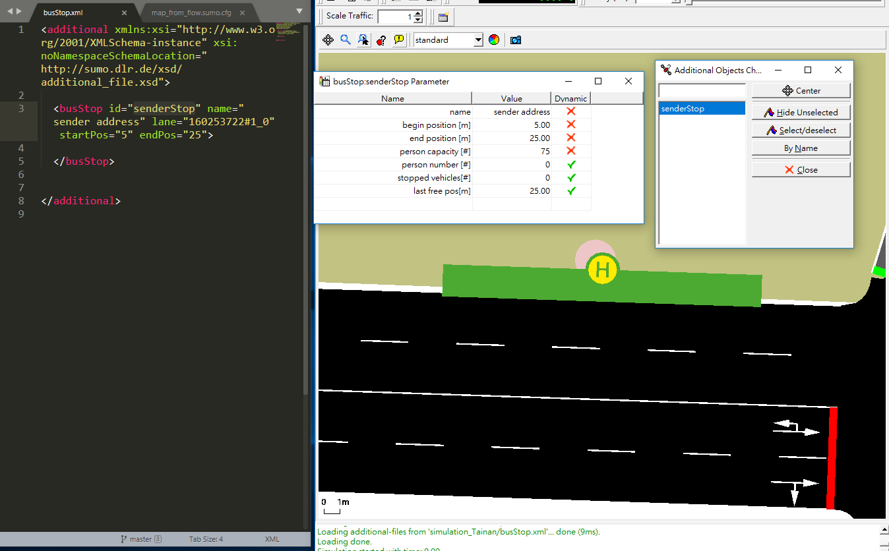

Slide 53
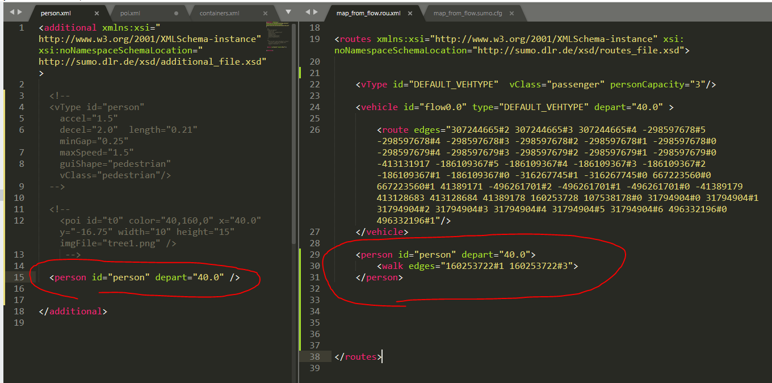
Error: element 'person' is not allowed for content model '(personTrip|ride|walk|stop|param)'

Slide 54
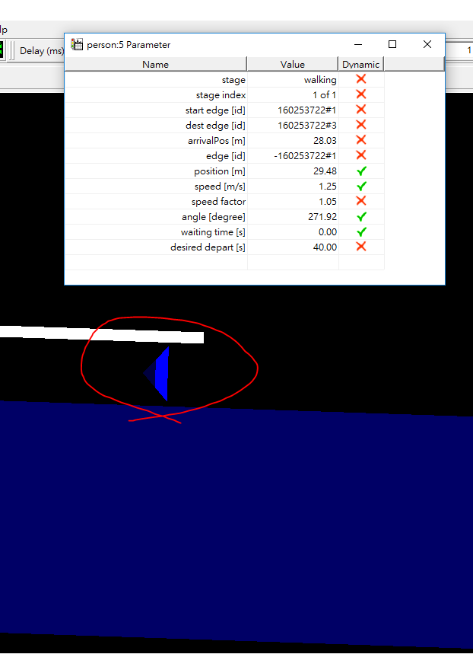
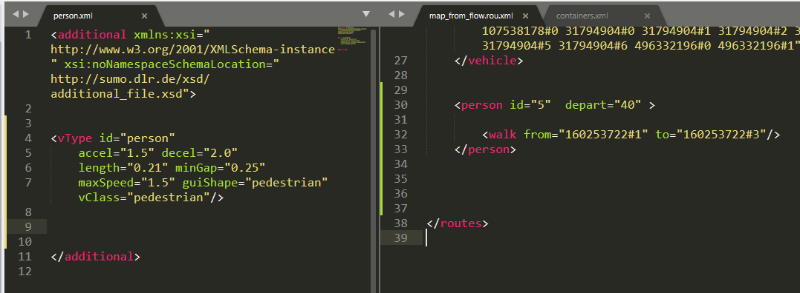

Slide 55
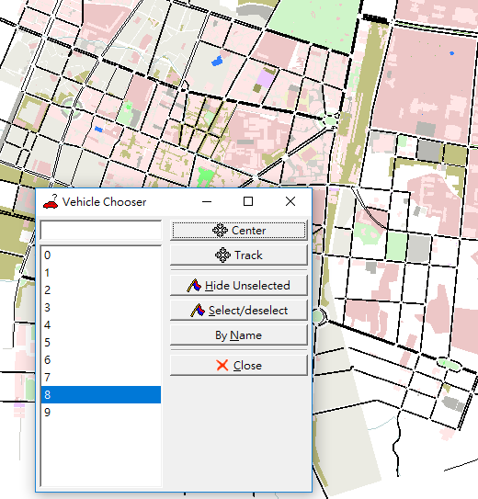
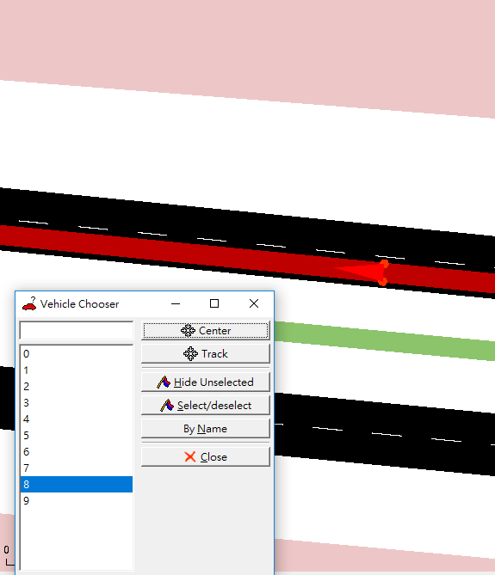
1.arrange 10 random cars in the more concise map

Slide 56

20s
40s
V8:10m
V8:35m
V9:33m
V9:50m

Slide 57
1s
2s
3s
current v8_edgeID is:313194185#3
current v8_position x:4522.27833916253 y:1920.8552667432366
current distance between v8 to sender is:5075.269336728843
current distance between v9 to sender is:4736.283500394948
current v8_edgeID is:313194185#3
current v8_position x:4519.158030583849 y:1921.896613339231
current distance between v8 to sender is:5073.342501706793
current distance between v9 to sender is:4739.520232601273
current v8_edgeID is:313194185#3
current v8_position x:4514.207321846696 y:1923.548822907995
current distance between v8 to sender is:5070.288245151509
current distance between v9 to sender is:4744.725440100539

Slide 58
Received the request of the sender at 60.0s
if((v9toSenderDistance< v8toSenderDistance) && timeSeconds==60.0 ) {
System.out.println("we dispath v9 to the sender address!");}
else if(v9toSenderDistance > v8toSenderDistance && (timeSeconds==60.0))
{System.out.println("we dispath v8 to the sender address!");}

Slide 59

Current edge
313194185#3
defaultRouteList:[313194185#3, 313194185#6, 313194185#11, 313194185#14, 496257370#0, 405115648#1,
313194390#0, 675775398, 496257372, -315702598#2, -228022792#6, -228022792#2, 72871344, 72871329#2, 72871329#3, 27067581, 228022808#0, 228022808#2, 228022808#4, 228022808#6, 306974310#0, 306974310#1]
changedRouteList:[313194185#3, 313194185#6, 313194185#11, 313194185#14, 496257370#0,
405115648#1,
-307096543#5, -537706053#4, -537706053#2]
405115648#1
-537706053#2
We need 75.56 s from current edge to sender address (Vmax=20 m/s)
306974310#1

Slide 60
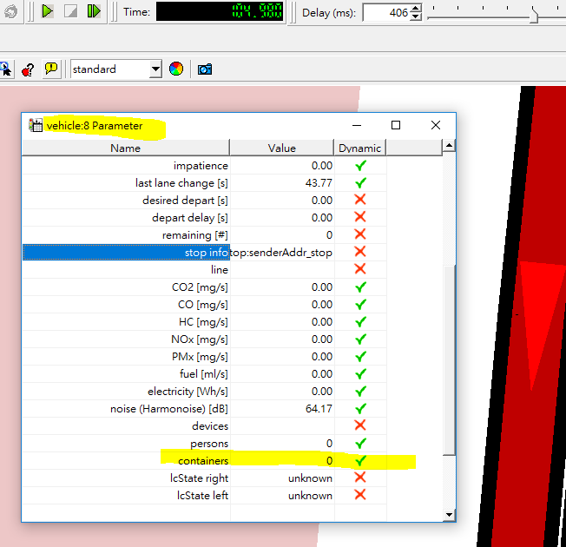
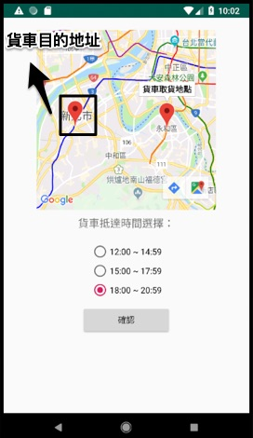
The condition to filter the suitable cars
1.shortest distance
2.containers number (Transporting? Lower than container capacity?)
3.the selection of time Interval

Slide 61
The selection of time Interval
12:00~14:59
lower bound:1hr58mins (1*60+58)*60*Vmax=141600 [m]
upper bound:4hr57min (4*60+57)*60*Vmax=356400 [m]
141600 < The distance < 356400
Current edge

Slide 62
Waiting time
Current time:10:02
The sender selected 18:00~20:59
If we assume the car would arrive to the sender’s address at 15:00,
we would make the car waiting at the place nearby the destination from 15:00~18:00
Current edge

Slide 63
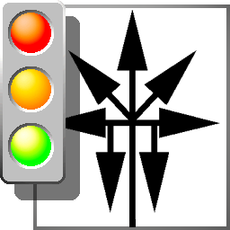


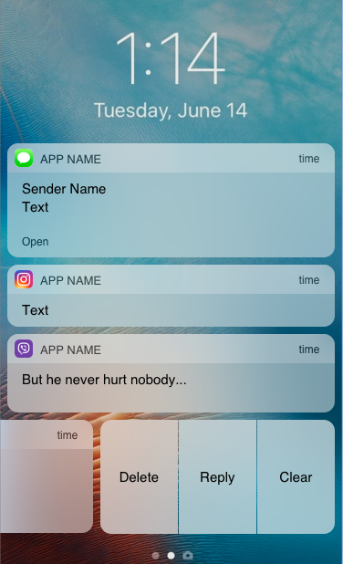
Notification to the sender with 2km
arrival signal
GCM
Sender
The sender would receive the message that the car would arrive to the destination within
5 minutes
2km

